Slide 1
LoveChat design
Hung Nguyen

Slide 2
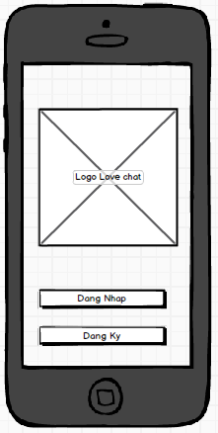
1) Start Screen
User co the dang ki hoac
dang nhap tren man hinh
nay

Slide 3
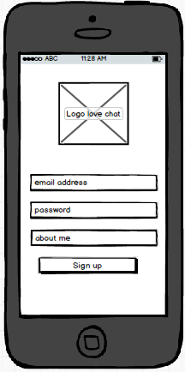
2) Form dang ki
User nhap email,password va
about me de dang ki tai khoan
Sau khi dang ki, co 1 email gui toi
User de kich hoat tai khoan

Slide 4
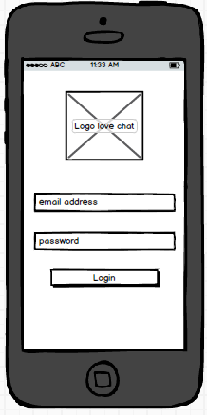
3) Form dang nhap
User nhap email va pass de dang
Nhap.
System tu dong dang nhap user
o nhung lan login sau do.

Slide 5
4. Giao dien chinh

Slide 6
5) Form Meet

Slide 7
6) Form Chat

Slide 8
7) Form Coins

Slide 9
8) Form Profile

Slide 10
9) Form chat detail

Slide 11
11

